Slide 1
Health-Related Quality of Life in Outcome Studies
Ron D. Hays, Ph.D
UCLA Division of General Internal Medicine & Health Services Research
GCRC Summer Session
July 18, 2011 (8:00-9:00 am)
1st floor Conference Room 1357, UCLA

Slide 2
Health-Related Quality of Life is …
What you can do.
Functioning
  Self-care
  Role
  Social
How you feel about your life.
Well-being
  Emotional well-being
  Pain
  Energy

Slide 3
Physical Health
Self-Reported Health
Mental Health
Social
Health

Slide 4
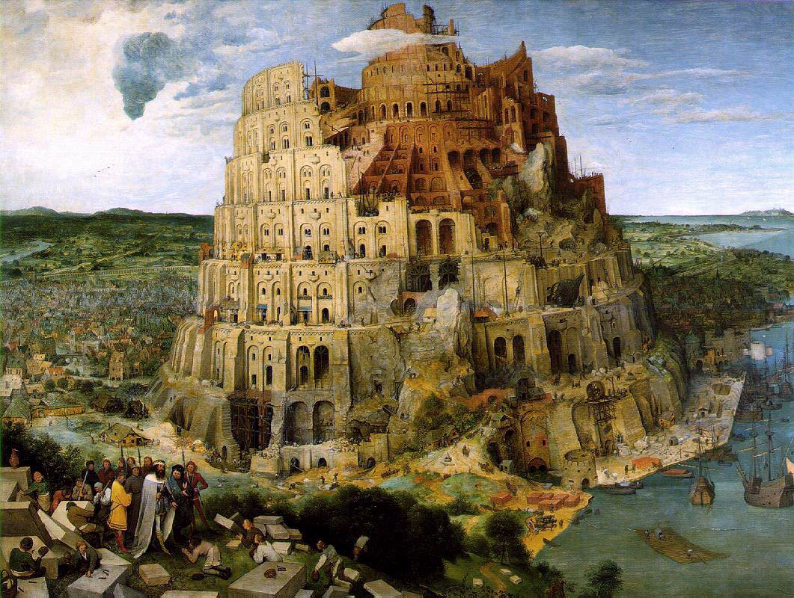
The Tower of Babel (Brueghel, 1563)

Slide 5
SF-36®
Physical functioning (10 items)
Role limitations/physical (4 items)
Role limitations/emotional (3 items)
Social functioning (2 items)
Emotional well-being (5 items)
Energy/fatigue (4 items)
Pain (2 items)
General health perceptions (5 items)

Slide 6
Patient-Reported Outcomes Measurement Information System (PROMIS), 2004-?
An answer to the “Tower of Babel”
A commitment of NIH to improve and standardize measurement of patient-reported outcomes (i.e., health-related quality of life)

Slide 7
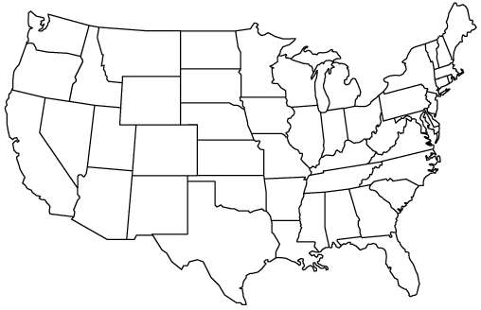
PROMIS-1 Network: 2004-2009
● University of Washington
●
Stony Brook
Northwestern ♥
● University of Pittsburgh
● NIH
● Stanford
UNC –Chapel Hill ●
● Duke University*
♥Coordinating Center

Slide 8
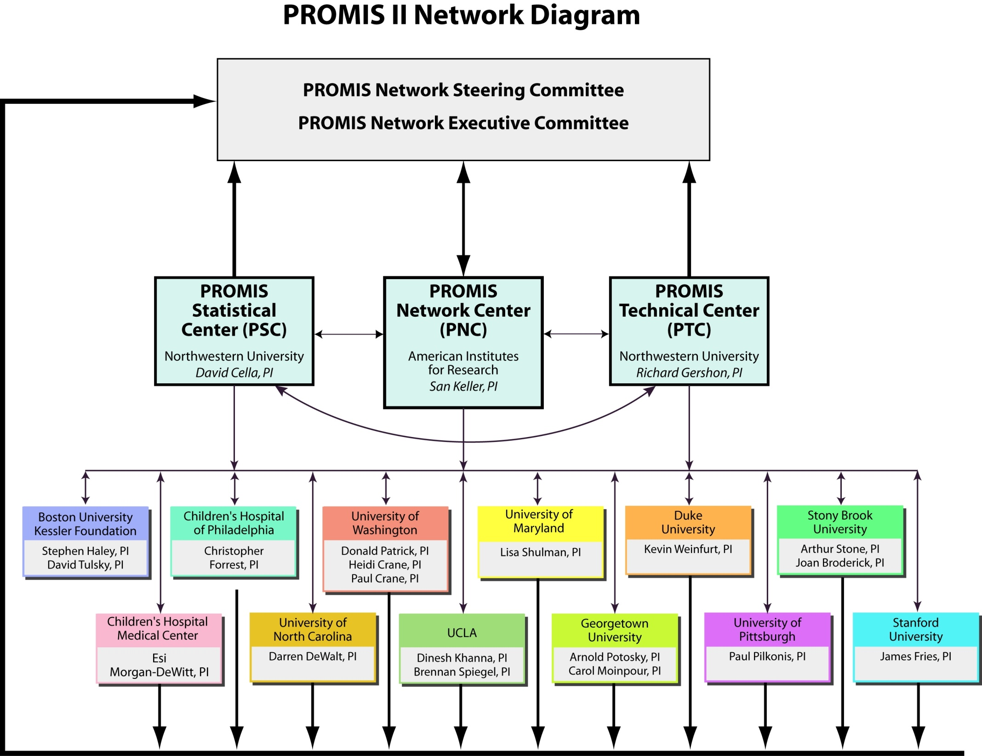

Slide 9
Literature
Review
Patient
Focus
Groups
Expert
Input and
Consensus
Existing
Items
Newly
Written
Items
Item Pool
Expert
Review
Translation
Cognitive
Testing
Secondary
Data Analysis





Questionnaire
administered to large
representative sample








Psycho-
metric
Testing
Item Bank
(IRT-calibrated items)
CAT
Short Form
Instruments

Slide 10
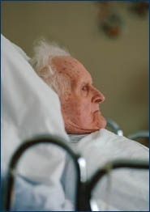
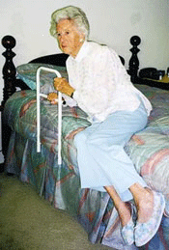
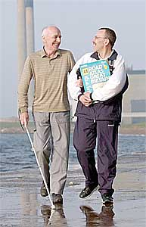
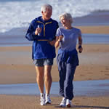
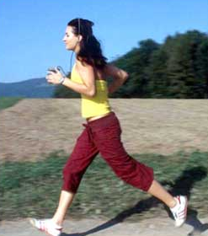
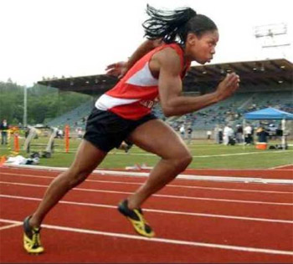











50
Physical Functioning Item Bank
Item
1
Item
2
Item
3
Item
4
Item
5
Item
6
Item
7
Item
8
Item
9
Item
n
Are you able to get in and out of bed?
Are you able to stand without losing your balance for 1 minute?
Are you able to walk from one room to another?
Are you able to walk a block on flat ground?
Are you able to run or jog for two miles?
Are you able to run five miles?

Slide 11
Computerized Adaptive Testing (CAT)
Select questions based on a person’s response to previously administered questions.
Iteratively estimate a person’s location on a domain (e.g., fatigue, depressive symptoms)
Administer most informative items
Desired level of precision can be obtained using the minimal possible number of questions.

Slide 12
Reliability and SEM
z-score (mean = 0 and SD = 1)
T-score = (z-score * 10) + 50
  Reliability = 1 – SEM² (for z-scores)
  = 0.91 (when SEM = 0.30)
  = 0.90 (when SEM = 0.32)
With 0.90 reliability
  95% Confidence Interval for score at mean
    z-score: - 0.62 → 0.62
    T-score: 43.8 → 56.2
www.nihpromis.org

Slide 13
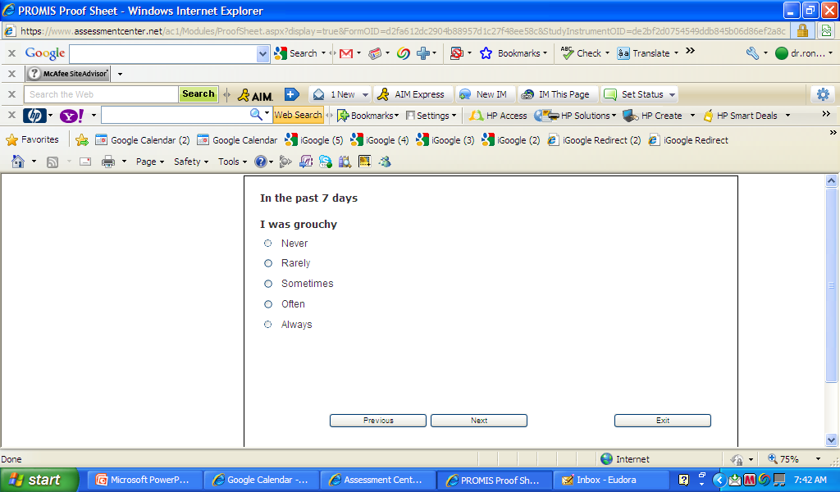
Notes:
Sometimes

Slide 14
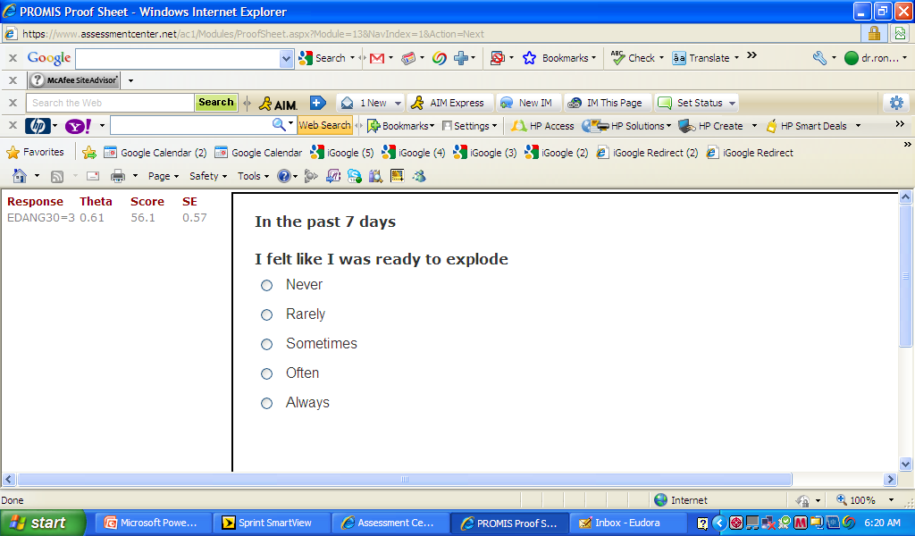
Notes:
Never

Slide 15
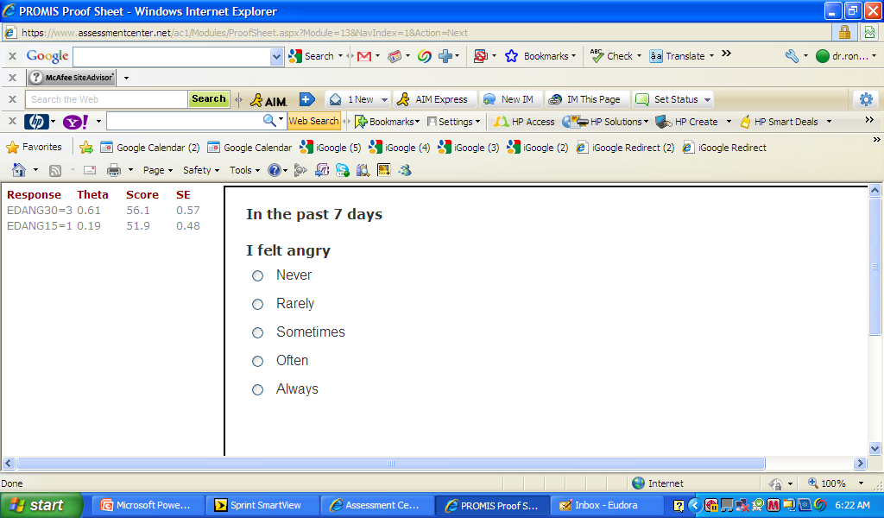
Notes:
Rarely

Slide 16
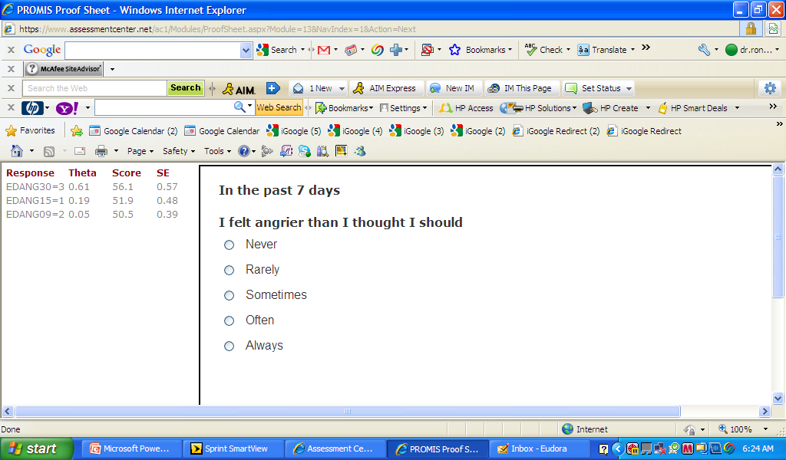
Notes:
Never

Slide 17
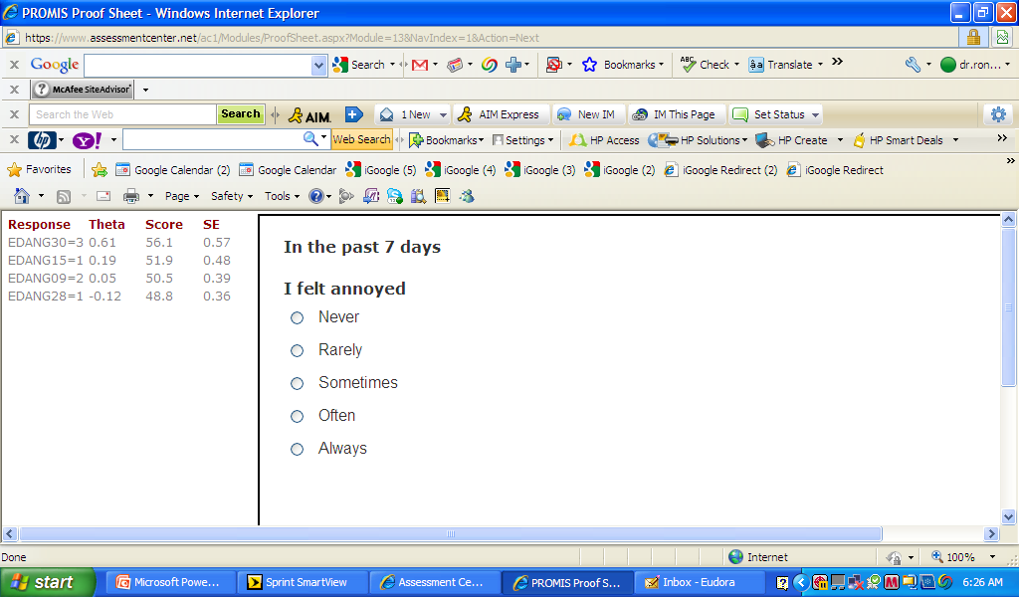
Notes:
Sometimes

Slide 18
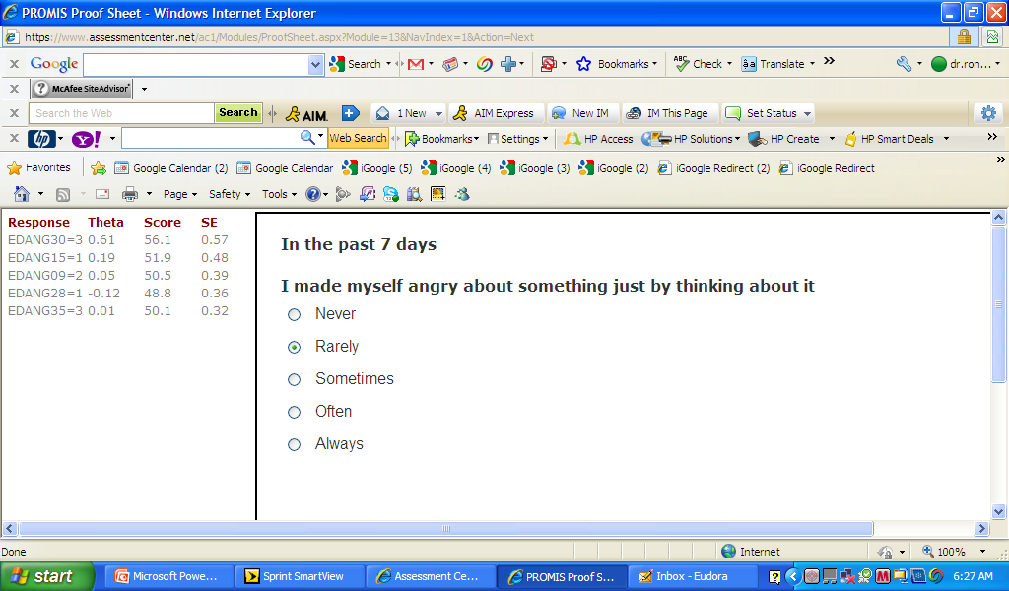
Notes:
Rarely

Slide 19
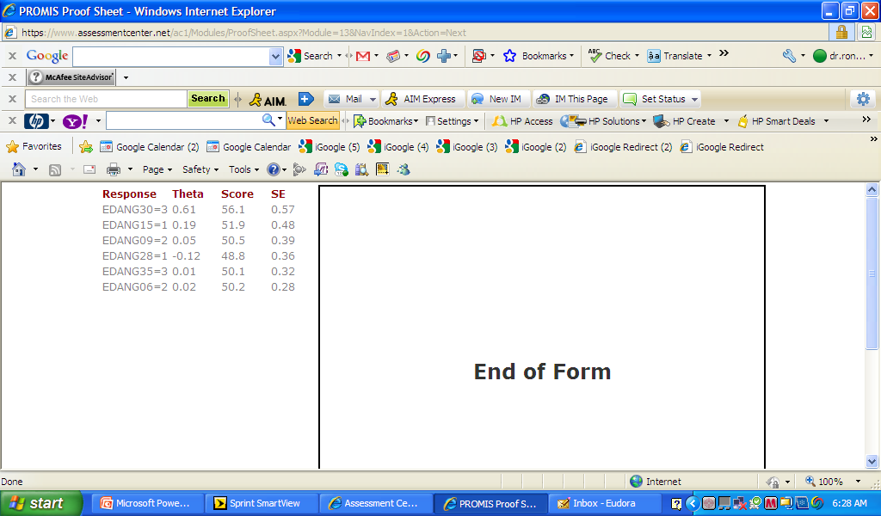

Slide 20
CAT assessments can achieve higher precision than fixed forms
measurement precision (standard error)
5
SF-12 items
4
SF-36 items
SE = 3.2
rel = 0.90
3
HAQ items
SE = 2.2
rel = 0.95
2
CAT 10 items
Full Item Bank
1
rheumatoid arthritis
patients
representative
sample
10 20 30 40 50 60 70
normed theta values
US-Representative Sample
Rose et al, J Clin Epidemiol 2007 (accepted)

Slide 21
PROMIS Profiles
8
6
4
Anxiety
Mental
Depression
Fatigue
Pain Interference
Physical
Sleep Disturbance
Physical Function
Social
Social Role
Notes:
The 7 sub-domains were selected to represent three higher level PROMIS domains, Mental Health, Physical Health, and Social Health. The short forms of different lengths, 4, 6, and 8 items, were designed to provide incrementally more precision and coverage for clinical populations.

Slide 22
Interpretation
Person Fatigue Score


































Low






High















Q
Q Q Q
Q Q Q
Q Q Q
Q
Q Q Q
Q
Q
Q
Likely
“I get tired
when I run
a marathon”
Unlikely
“I get tired
when I get
out of a
chair”
Q Q Q
Q Q Q
Q Q Q
Q Q Q
Q
Q Q Q
Q Q Q
Q
Q Q Q
Q
Q Q Q
Q Q Q
Q
Q Q Q
Item Location
Notes:
Likely item: I get tired when I run a marathon (T)
Unlikely item: I get tired when I get out of bed (T)

Slide 23
Interpretation Aids


































Low






High















30
40
50
60
70
M = 50, SD = 10
T = (z * 10) + 50

Slide 24
Example of high fatigue
Fatigue Score=60


































Low






High















30
40
50
60
70
This patient’s fatigue score is 60, significantly worse than average (50). People who score 60 on fatigue tend to answer questions as follows:
…”I have been too tired to climb one flight of stairs: VERY MUCH
…”I have had enough energy to go out with my family: A LITTLE BIT

Slide 25
Example of low fatigue
Fatigue Score=40


































Low






High















30
40
50
60
70
This patient’s fatigue score is 40, significantly better than average (50). People who
score 40 on fatigue tend to answer questions as follows:
…”I have been too tired to climb one flight of stairs: NOT AT ALL
…”I have had enough energy to go out with my family: VERY MUCH

Slide 26
Significant Improvement in all but 1 of SF-36 Scales (Change is in T-score metric)
Change
t-test
prob.
PF-10
1.7
2.38
.0208
RP-4
4.1
3.81
.0004
BP-2
3.6
2.59
.0125
GH-5
2.4
2.86
.0061
EN-4
5.1
4.33
.0001
SF-2
4.7
3.51
.0009
RE-3
1.5
0.96
.3400
EWB-5
4.3
3.20
.0023
PCS
2.8
3.23
.0021
MCS
3.9
2.82
.0067
26

Slide 27
Defining a Responder: Reliable Change Index (RCI)
Note: SD_{bl} = standard deviation at baseline
r_{xx} = reliability
27

Slide 28
Amount of Change in Observed Score
Needed for Significant Individual Change
Scale
Change
Effect size
Reliability
PF-10
8.4
0.67
0.94
RP-4
8.4
0.72
0.93
BP-2
10.4
1.01
0.87
GH-5
13.0
1.13
0.83
EN-4
12.8
1.33
0.77
SF-2
13.8
1.07
0.85
RE-3
9.7
0.71
0.94
EWB-5
13.4
1.26
0.79
PCS
7.1
0.62
0.94
MCS
9.7
0.73
0.93
28

Slide 29
7-31% of People in Sample Improve Significantly
% Improving
% Declining
Difference
PF-10
13%
2%
+ 11%
RP-4
31%
2%
+ 29%
BP-2
22%
7%
+ 15%
GH-5
7%
0%
+ 7%
EN-4
9%
2%
+ 7%
SF-2
17%
4%
+ 13%
RE-3
15%
15%
0%
EWB-5
19%
4%
+ 15%
PCS
24%
7%
+ 17%
MCS
22%
11%
+ 11%
29

Slide 30

Questions?

