Slide 1
Overlap between Subjective Well-being and Health-related Quality of Life.
3
Ron D. Hays, Ph.D.
(Alina Palimaru)
November 18, 2015 (11:30-12:00 noon)
Geriatric Society of America
Subjective Well-being Assessment in
Minority Aging Research
Walt Disney World Swan & Dolphin Orlando, Florida

Slide 2

Hedonic or Experienced Well-Being (Bentham)
Emotional states or mood over short periods of time.
“Did you experience anger
during a lot of the day
yesterday?”
  Yes
  No

Slide 3

Eudemonic Well-Being (Aristotle)
Perceived purpose and fulfillment
“Overall, to what extent do
you feel that the things you
do in your life are worthwhile?”
  Not at all (0) – 10 (Completely)

Slide 4

Evaluative Well-Being
Overall appraisal of one’s life
“How satisfied are you with your life in general?”
  Very satisfied
  Somewhat satisfied
  Somewhat dissatisfied
  Very dissatisfied

Slide 5

Health-Related Quality of Life (HRQOL)
How the person FEELs (well-being)
  Emotional well-being
  Pain
  Energy
What the person can DO (functioning)
  Self-care
  Role
  Social

Slide 6
Spiro and Bossé (2000)
Mental and social health aspects of HRQOL are often empirically associated with subjective well-being
  “the constructs of wellbeing and health-related quality of life overlap (p. 299).
“Relations between health-related quality of life and well-being: The gerontologist’s new clothes?” International Journal of Aging and Human Development, 50, 297-318.

Slide 7
Patient Reported Outcomes Measurement Information System (PROMIS) Framework
Upper Extremities: grip, buttons, etc (dexterity)
Function/Disability
Lower Extremities: walking, arising, etc (mobility)
Central: neck and back (twisting, bending, etc)
Physical Health
Activities: IADL (e.g. errands)
Pain
Fatigue
Satisfaction
Symptoms
Sleep/Wake Function**
Sexual Function
Other
Anxiety
Self-reported Health
Depression
Emotional Distress
Anger/Aggression
Mental Health
Substance Abuse
Self Concept
Stress Response
Spirituality/Meaning
Social Impact
Cognitive Function
Negative Impacts of illness
Satisfaction
Positive Impacts of Illness
Satisfaction
Positive Psychological Functioning
Meaning and Coherence (spirituality)
Mastery and Control (self-efficacy)
Subjective Well-Being (positive affect)
Social Health
Role Participation
Performance
Satisfaction
Social Support
Satisfaction

Slide 8
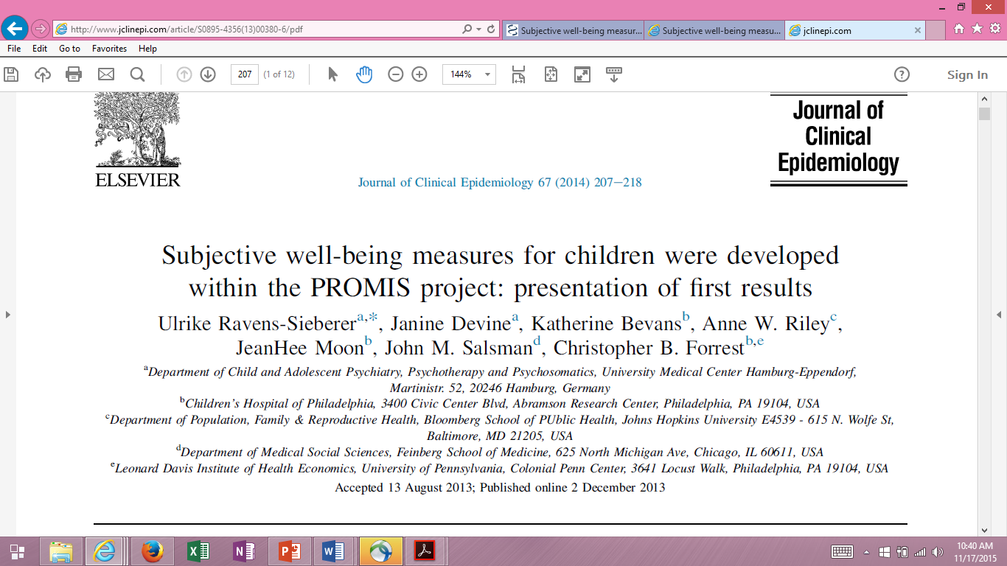

Slide 9
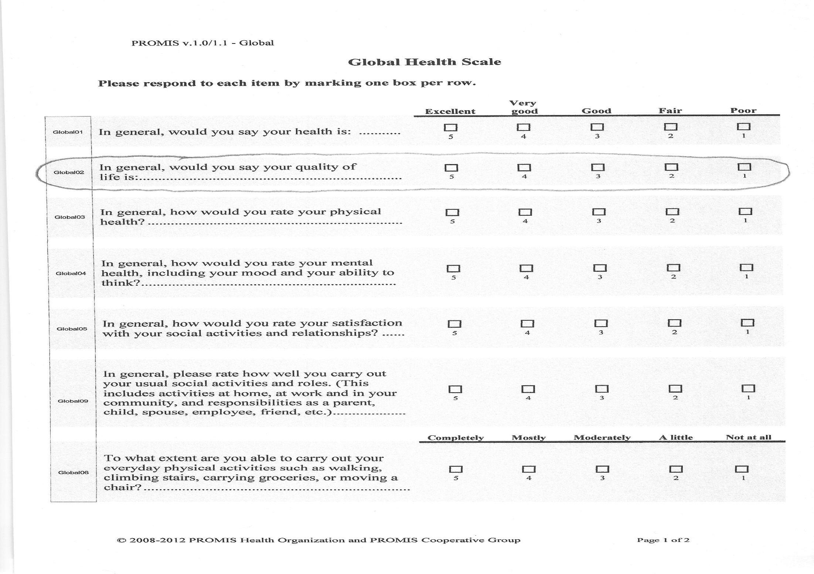

Slide 10
PROMIS® Adult Data
Wave 1: Polimetrix (now YouGov)
  Included EQ-5D preference-based measure
    5 attributes (self-care, usual activities, mobility, pain/discomfort, anxiety/depression)
    Ranges from -0.11 to 1.00
Wave 2: Op4G (https://op4g.com/)
  Included HUI-3 preference-based measure
    8 attributes (vision, hearing, speech, ambulation, dexterity, emotion, cognition, pain)
    Ranges from -0.36 to 1.00
Non-probability based recruitment of panels
Hays, R. D., Liu, H., & Kapteyn, A. (2015). Use of internet panels to conduct surveys. Behavior Research Methods., 47 (3), 685-690.

Slide 11
Characteristics of PROMIS adult samples
Characteristic | Wave 1 (N=21,133) | Wave 2 (N=2,996)
Age (median) | 50 | 52
Female Gender | 52% | 51%
Race / Ethnicity
Latino | 9% | 11%
Non-Hispanic Black | 9% | 15%
Non-Hispanic White | 80% | 63%
Other | 2% | 11%
Education
Less than High School | 3% | 14%
High School graduate | 16% | 31%
More than High School | 43% | 55%
Note: 28% of wave 1 and 17% of wave 2 were 65 or older.

Slide 12
PROMIS Global Health
Items Dimensionality (Wave 1)
Item-scale correlations
  Ranged from 0.53 to 0.80
Internal consistency reliability = 0.92
Confirmatory factor analysis (categorical) for one-factor model
  CFI = 0.927
  RMSEA = 0.249 (note: < .06 desirable)
PCA eigenvalues: 6.25, 1.20, 0.75, …
12
Notes:
12

Slide 13
Global Physical Health Scale
1. In general, how would you rate your physical health?
2. To what extent are you able to carry out your everyday physical activities …?
3. How would you rate your pain on average?
4. How would you rate your fatigue on average?
13
Notes:
13

Slide 14
Global Mental Health Scale
1. In general, would you say your quality of life is?
2. In general, how would you rate your mental health?
3. In general, how would you rate your satisfaction with social activities and relationships?
4. How often have you been bothered by emotional problems?
14
Notes:
14

Slide 15
Regression of Overall Rating of Quality of Life on PROMIS global health
and EQ-5D-3L items in PROMIS Wave 1 (Adjusted R² = 0.69)
 | Standardized Beta | t-statistic | p-value | Zero order correlation*
Satisfaction with social activities and relationships | 0.27 | 36.34 | <0.0001 | 0.68
Physical health | 0.20 | 16.98 | <0.0001 | 0.70
General health | 0.18 | 15.07 | <0.0001 | 0.69
Mental health | 0.17 | 20.34 | <0.0001 | 0.64
Perform social activities and roles | 0.12 | 14.50 | <0.0001 | 0.67
Usual activities (EQ-5D) | 0.04 | 5.36 | <0.0001 | 0.50
Physical functioning | 0.03 | 3.19 | 0.0014 | 0.50
Pain | 0.02 | 2.69 | 0.0072 | 0.44
Emotional problems | 0.01 | 0.90 | 0.3701 | 0.48
Self-care (EQ-5D) | 0.01 | 2.67 | 0.0077 | 0.29
Mobility (EQ-5D) | 0.01 | 0.84 | 0.6807 | 0.40
Pain/discomfort (EQ-5D) | 0.00 | 0.48 | 0.6298 | 0.42
Anxiety/depression (EQ-5D) | 0.00 | 0.19 | 0.8507 | 0.46
Fatigue | -0.01 | -1.76 | 0.0789 | 0.50
* All p’s < 0.0001

Slide 16
EQ-5D Scores by
0.92
0.87
0.79
0.65
0.48
EQ-5D mean overall = 0.82 (SD = 0.17)

Slide 17
Regression of Overall Rating of Quality of Life on PROMIS global health
and HUI3 in PROMIS Wave 2 (Adjusted R² = 0.75)
 | Standardized Beta | t-statistic | p-value | Zero order correlation*
Physical health | 0.39 | 22.04 | <.0001 | 0.82
General health | 0.27 | 16.45 | <.0001 | 0.79
Mental health | 0.11 | 7.94 | <.0001 | 0.66
Satisfaction with social activities and relationships | 0.09 | 6.01 | <.0001 | 0.64
Perform social activities and roles | 0.06 | 4.37 | <.0001 | 0.62
Physical functioning | 0.03 | 2.58 | 0.0101 | 0.56
HUI-3 | 0.03 | 2.19 | 0.0287 | 0.48
Pain | 0.01 | 0.64 | 0.5235 | 0.36
Fatigue | 0.01 | 0.93 | 0.3504 | 0.48
Emotional problems | -0.003 | -0.33 | 0.7437 | 0.39
* All p’s < 0.0001

Slide 18
Summary
Evaluative well-being measures are indicators of mental health(-related quality of life).
Overall quality of life (indicator of subjective well-being) is closely related to health-related quality of life measures.
Need for more collaboration between International Society of Quality of Life Studies and International Society for Quality of Life Research

Slide 19


Thank you!
Supported by
NIA (P30-AG021684)
drhays@ucla.edu

