Slide 1

Methods for Assessing Safety Culture:
A View from the Outside
October 2, 2014 (9:30 – 10:30 EDT)
Safety Culture Conference
(AHRQ Watts Branch Conference Room)
Ron D.Hays, Ph.D.
UCLA Department of Medicine
RAND Health Program

Slide 2
Patient Safety Culture Measures
AHRQ Hospital Survey on Patient Safety Culture (HSOPSC)
  http://www.ahrq.gov/legacy/qual/patientsafetyculture/hospsurvindex.htm
Safety Attitudes Questionnaire (SAQ)
  https://med.uth.edu/chqs/surveys/safety-attitudes-and-safety-climate-questionnaire/
Patient Safety Climate in Healthcare Organizations (PSCHO) Survey
  http://www.midss.org/content/patient-safety-climate-healthcare-organizations-pscho

Slide 3
AHRQ Hospital Survey on Patient Safety Culture (HSOPSC)
42 items measuring 12 domains
  Supervisor/manager expectations (k = 4)
  Organizational learning/Cont. improve (k = 3)
  Teamwork within units (k = 4)
  Teamwork across units (k = 4)
  Communication openness (k = 3)
  Feedback/comm. about error (k = 3)
  Non-punitive response to error (k = 3)
  Staffing (k = 4)
  Management support for safety (k = 3)
  Handoffs/transitions (k = 4)
  Frequency of events reports (k = 3)
  Overall perceptions of patient safety (k = 4)

Slide 4
Safety Attitudes Questionnaire (SAQ)
30 items measuring 6 domains
  Safety climate (k = 7)
  Teamwork climate (k = 6)
  Perceptions of management (k = 4)
  Job satisfaction (k = 5)
  Working conditions (k = 4)
  Stress recognition (k = 4)

Slide 5
Patient Safety Climate in Healthcare Organizations (PSCHO) Survey
37 items measuring 7 domains
  Senior managers’ engagement (k = 7)
  Organizational resources (k = 3)
  Overall emphasis on patient safety (k = 3)
  Unit safety norms (k = 7)
  Unit support/recognition for safety effort (k = 4)
  Fear of blame (k = 2)
  Fear of shame (k = 5)
  Provision of safe care (k = 3)
  Learning (k = 3)

Slide 6
Qualitative Observations (HSOPSC)
Response options

Slide 7
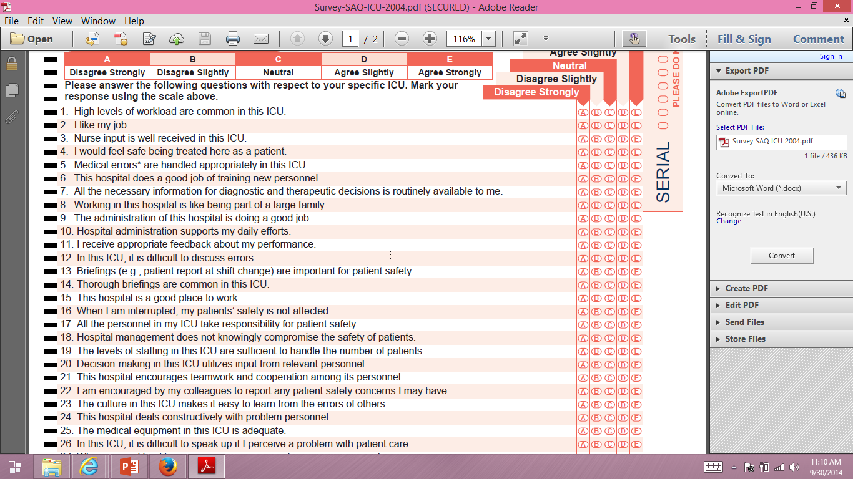
Qualitative Observations (SAQ)

Slide 8
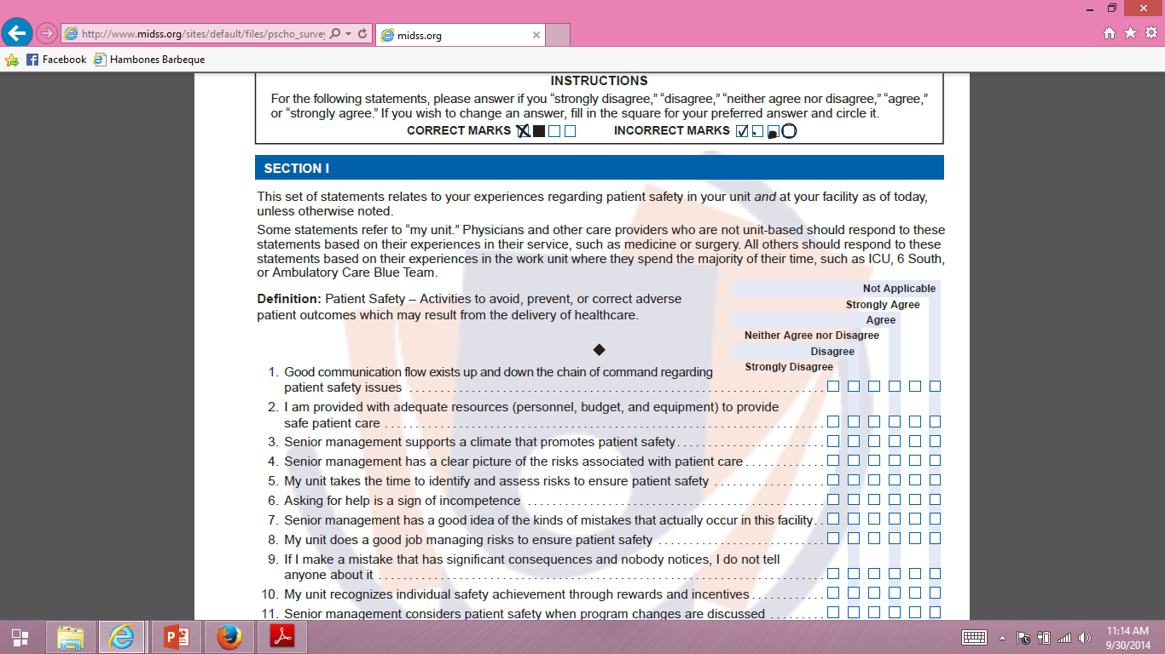
Qualitative Observations (PSCHO)

Slide 9
Reliability
Degree to which the same score is obtained when the target or thing being measured (person, plant or whatever) hasn’t changed.
Internal consistency (items)
  Need 2 or more items
Test-retest (administrations)
  Need 2 or more time points
Inter-rater (rater)
  Need 2 or more raters of the thing being measured

Slide 10
Reliability Formulas
Model
Reliability
Intraclass Correlation
Two-way random
Two-way mixed
One-way
BMS = Between Ratee Mean Square N = n of ratees
WMS = Within Mean Square k = n of items or raters
JMS = Item or Rater Mean Square
EMS = Ratee x Item (Rater) Mean Square
Notes:
10

Slide 11
Reliability Formulas
Model
Reliability
Intraclass Correlation
Two-way random
Two-way mixed
One-way
BMS = Between Ratee Mean Square N = n of ratees
WMS = Within Mean Square k = n of items or raters
JMS = Item or Rater Mean Square
EMS = Ratee x Item (Rater) Mean Square
Notes:
11

Slide 12
Reliability Formulas
Model
Reliability
Intraclass Correlation
Two-way random
Two-way mixed
One-way
BMS = Between Ratee Mean Square N = n of ratees
WMS = Within Mean Square k = n of items or raters
JMS = Item or Rater Mean Square
EMS = Ratee x Item (Rater) Mean Square
Notes:
12

Slide 13
r_{wg} (i)
1 – (Sx_{j}² / sigma_{EU}²)
  Within-group interrater reliability for Xj (Proportion of non-error variance)
  Sx_{j}² = observed variance on X_{j}
  Sigma_{EU}² = variance on X_{j} if all judgements were due to random measurement error
    Expected error variance based on uniform distribution.
    (NCAT² – 1)/12
James et al. (1984, J App Psych)

Slide 14

Item-scale correlation matrix
14
Notes:
14

Slide 15

Item-scale correlation matrix
15
Notes:
15

Slide 16
Confirmatory Factor Analysis
16
Notes:
16

Slide 17
Validity
Does scale represent what it is supposed to be measuring?
Singer et al. (2009)
  Hospitals with better safety climate overall had lower relative incidence of patient safety indicators
  Frontline personnel’s (not senior manager’s) perceptions of better safety climate were associated with lower incidence of patient safety indicators

Slide 18
New Directions
Standardized General Population Metric
Category Response Curves
Computer Adaptive Testing
Differential Item Functioning
Linking of Different Measures

Slide 19
T-score Metric
T Score
  Mean = 50
  SD = 10
  Referenced to US “General” Pop.
  T = 50 + (z * 10)

Slide 20
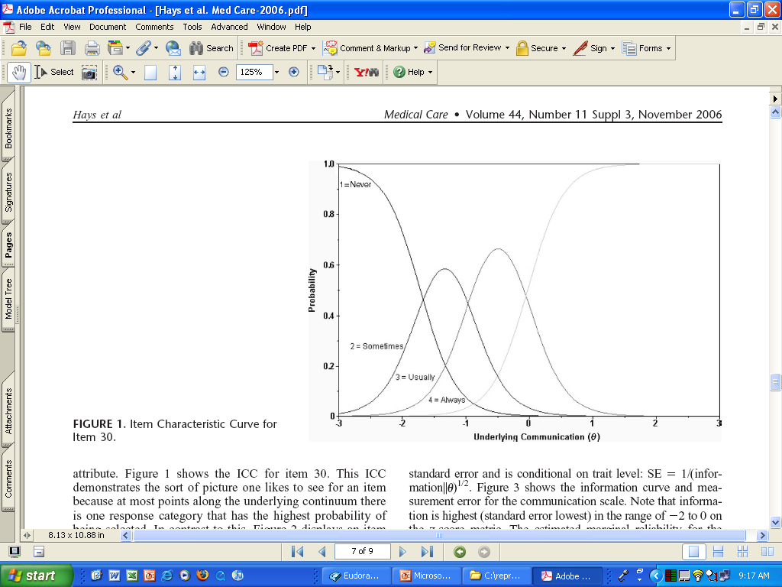
CATEGRORY RESPONSE CURVE

Slide 21
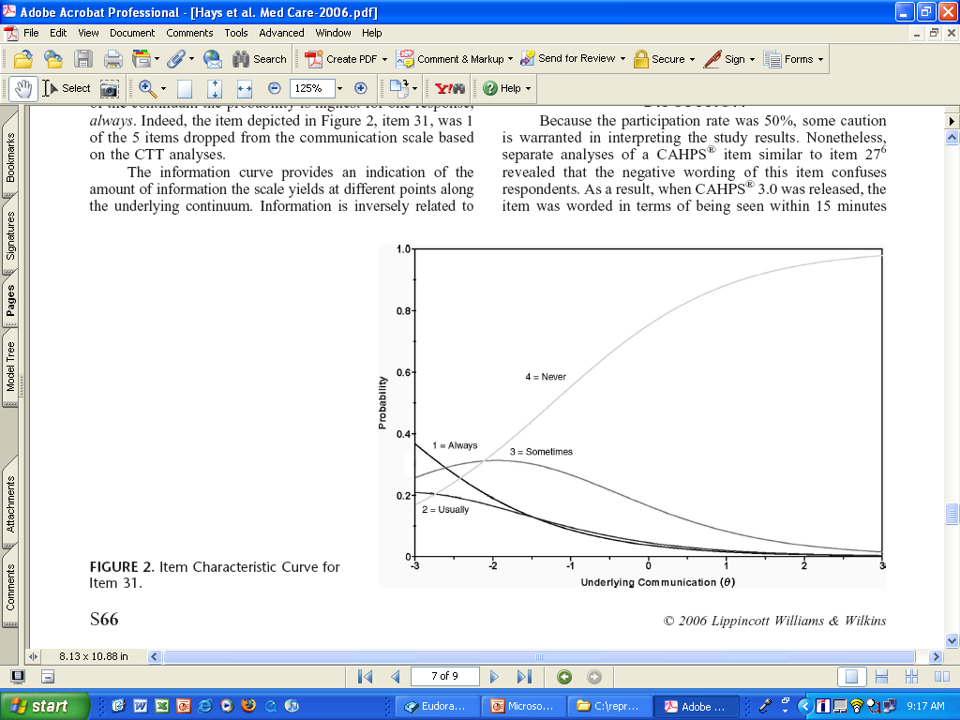

Slide 22
Item Responses and Trait Levels
Person 1
Person 2
Person 3
Trait
Continuum
Item 1
Item 2
Item 3
www.nihpromis.org

Slide 23




Computer Adaptive Testing (CAT)
Notes:
Early research on CAT was funded by the U.S. military to enhance mental measurement.
NASD = National Association of Security Dealers. In 1978 they began developing CAT for regulatory exam to assess knowledge of securities and securities future products among licensed brokers.
The National Council of State Boards of Nursing starting using CAT in 1994.

Slide 24
PROMIS Physical Functioning vs. “Legacy” Measures
10 20 30 40 50 60 70

Slide 25
Differential Item Functioning (DIF)
Probability of choosing each response category should be the same for those who have the same estimated scale score, regardless of other characteristics
Evaluation of DIF by subgroups

Slide 26
DIF (2-parameter model)
Men
Women
White
Slope DIF
Location DIF
AA
I cry when upset
I get sad for no reason
Higher Score = More Depressive Symptoms
Notes:
26

Slide 27
Linking of Measures (Etchegaray & Thomas, 2012)
R-squared for SAQ teamwork = 54%
0.83 + 0.34* HSOPSteamwork + 0.51* HSOPScommun.
R-squared for SAQ safety = 42%
1.63 + 0.65* HSOPorganizational learning

Slide 28
Linking
Assumes
  Instruments are measuring essentially the same thing (unidimensional)
Correlations among SAQ and HSOPS
  Etchegaray & Thomas (2012) Table 4
  Predominantly unidimensional
    8.2, 1.28 and 0.96 are 1st 3 principal components
  If two factors rotated 2nd factor shows common variance among 5 HSOPS scales
    Teamwork within, non-punitive, number of events reported, expectations, and staffing

Slide 29
Linking
Assumes
  Instruments are measuring essentially the same thing (unidimensional)
  Scores from the two instruments are highly correlated (> 0.80); compare actual with estimated scores
  Subgroup invariance (standardized root mean square deviation)
Equipercentile linking of scores
  Scores associated with equivalent % ranks
IRT linking

Slide 30

drhays@ucla.edu (310-794-2294).
Notes:
30

Slide 31
Bibliography
DiCuccio, M. H. (2014). The relationship between patient safety culture and patient outcomes: A systematic review. J Patient Saf, epub.
Etchegary, J. M., & Thomas, E. J. (2012). Comparing two safety culture surveys: Safety Attitudes Questionnaire and Hospital Survey on Patient Safety. BMJ Qual Sat, 21, 490-498.
Morello, R. T. et al. (2013). Strategies for improving patient safety culture in hospitals: A systematic review. BMJ Qual Saf, 22, 11-18.
Sammer, C. E., Lykens, K., Singh, K. P., Mains, D. A., & Lackan, N. A. (2010). What is patient safety culture? A review of the literature. Journal of Nursing Scholarship, 42, 156-165.
Sexton, J. B. et al. (2011). Assessing and improving safety climate in a large cohort of intensive care units. Crit Care Med, 39, 934-939.
Sexton, J. B. et al. (2006). The Safety Attitudes Questionnaire: Psychometric properties, benchmarking data, and emerging research. BMC Health Services Research, 6, 44.
Singer, S. et al. (2009). Relationship of safety climate and safety performance in hospitals. Health Services Research, 44, 399-421.
Singer, S. et al. (2007). Workforce perceptions of hospital safety culture: Development and validation of the Patient Safety Climate in Healthcare Organizations Survey. Health Services Research, 42, 1999-2021
Sorra, J. S., & Dyer, N. (2010). Multilevel psychometric properties of the AHRQ hospital survey on patient safety culture. BMC Health Services Research, 10, 199.

